Slide 1
WORLD CUP 2019
Analysis on : Predictive analysis
Analysis done by: Aashumi mehta
Karthick Santhosh
Pooja BORA

Slide 2
INTRODUCTION
A predictive analysis model for 2019 men's Cricket World Cup.
This model is developed based on the historical data collected for the 10 participating teams.
Afghanistan
Australia
Bangladesh
England
India
New Zealand
Pakistan
South Africa
Sri Lanka
West Indies

Slide 3
FEATURES
Bowling Features
Mat_Bowl | Number of matches
Inns_Bowl | Number of innings in a tournament
Balls | Number of balls
Runs_Bowl | Runs given by the bowler
Wkts | Wickets taken by the bowler
Ave_Bowl | Bowlers Average
Econ | Economy rate of the bowler
SR_Bowl | Strike rate of the bowler
4w | 4 wickets taken in a single match
5w | 5 wickets taken in a single match
Notes:
Number of innings and number of matches depends upon the match conditions(eg if a batsman comes in for batting or no)

Slide 4
FEATURES
Batting Features
Mat_Bat | Number of matches
Inns_Bat | Number of innings in a tournament
NO | Not outs
Runs_Bat | Runs score by the batsman
HS | Highest runs scored by the batsman
Ave_Bat | Batting Average
BF | Best figures of the batsman in that tournament
SR_Bat | Strike rate of the batsman
100 | Century scored by the batsman
50 | Half century scored by the batsman
Notes:
Number of innings and number of matches depends upon the match conditions(eg if a batsman comes in for batting or no)

Slide 5
FEATURES
Fielding Features
Ct | Number of catches
St | Number of stumpings in a tournament
Notes:
Number of innings and number of matches depends upon the match conditions(eg if a batsman comes in for batting or no)

Slide 6
BUSINESS PROBLEM
To analyze the World Cup winners till date and how they differ from each world cup.
Visualize the player performance and team performance over the years to identify the best players and best team.
Collect the historical data, use this as training data to predict a model and test the model on 2019 players data.
The predictive analysis strategy should be useful for viewers, sponsors and team strategists.

Slide 7
Training Data
To train our model, we utilize the data collected from every men’s cricket world cup.
From 1975 to the present, there have been 11 world cups (1975, 1979, 1983, 1987, 1992, 1996, 1999, 2003, 2007, 2011 and 2015) played so far.
One thing to be noticed is that until 1983 world cup, each team played 60 overs each whereas from 1987 onwards, 50 overs.
Also, run scoring has increased incredibly over the last few years, that will be considered in our features as well.

Slide 8
ICC EVENTS VISUALIZATION (ASIA CUP & CHAMPIONS TROPHY)

Slide 9
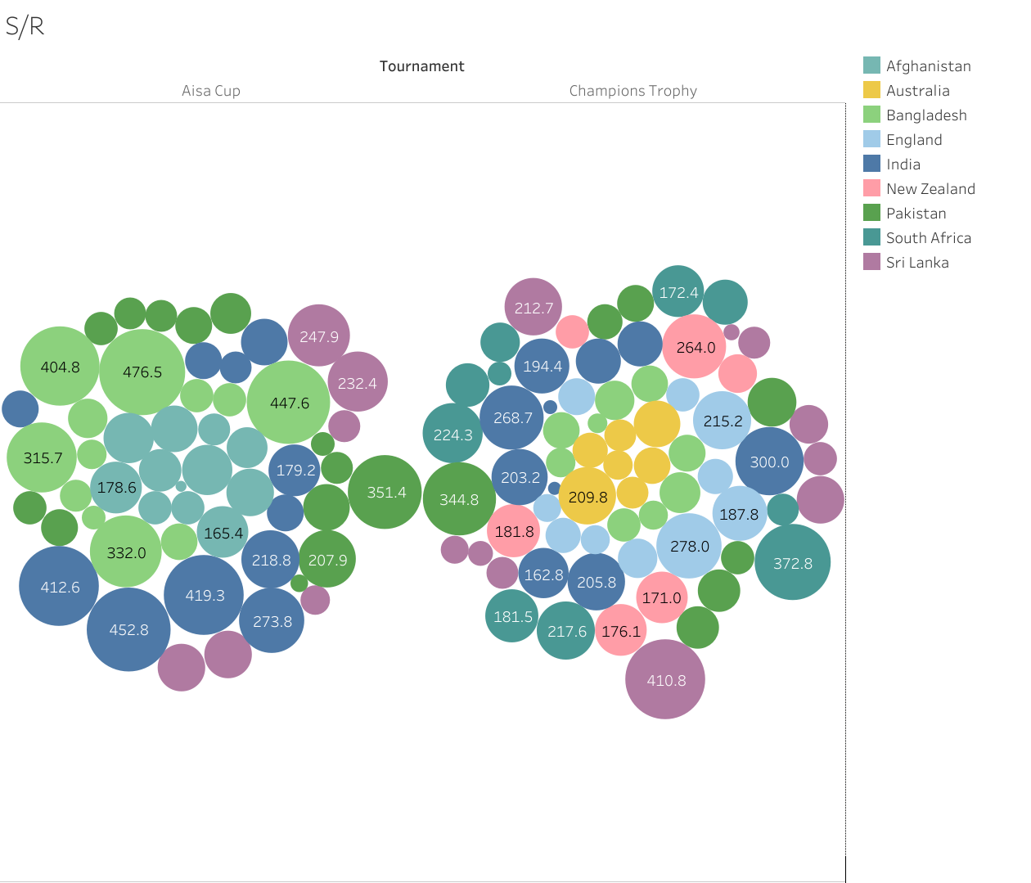
STRIKE RATE

Slide 10
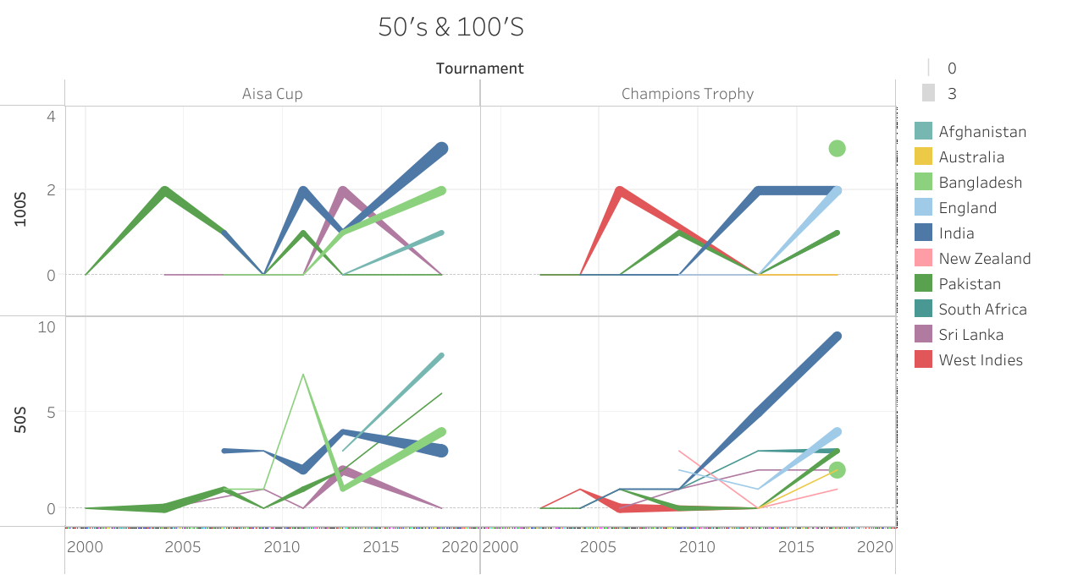
50’S & 100’S

Slide 11
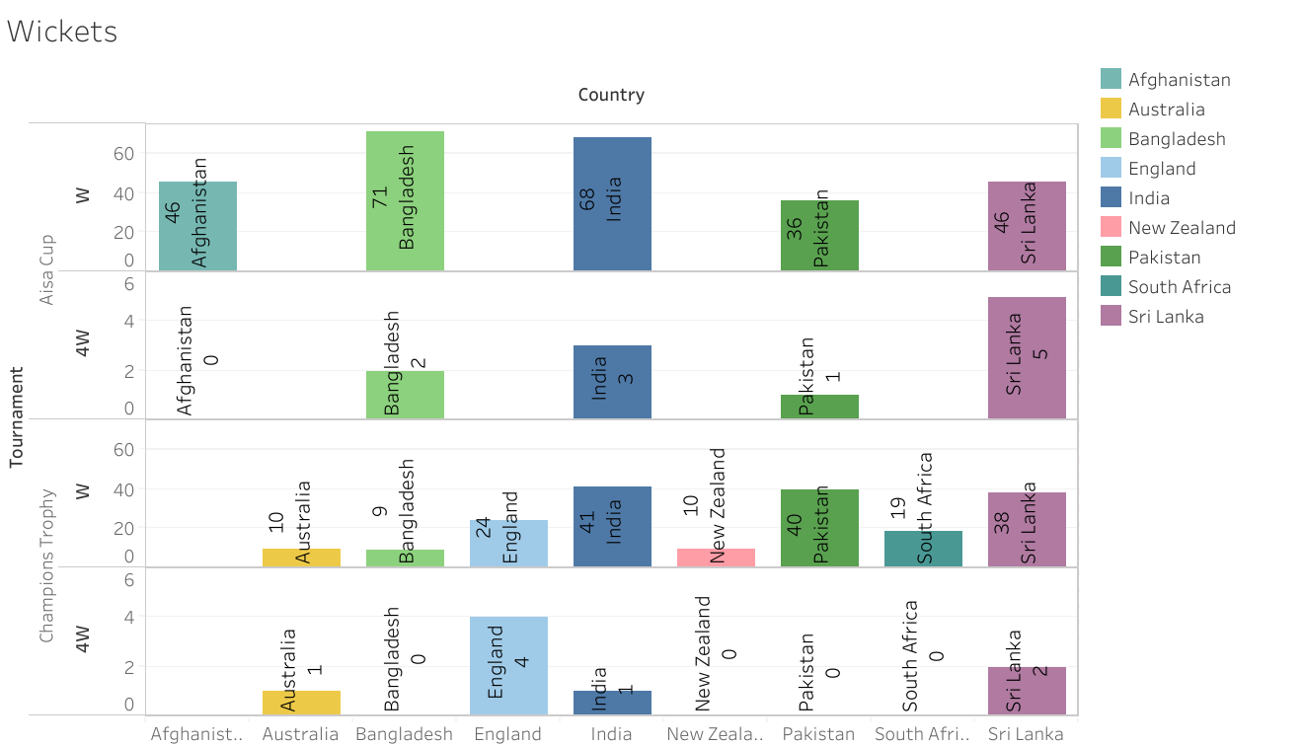
WICKETS

Slide 12
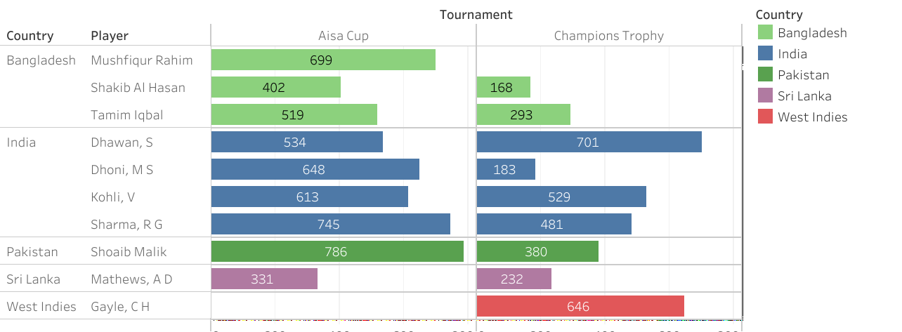
TOP SCORING PLAYERS

Slide 13
ODI PERFORMANCE OF PLAYERS (2018-2019)

Slide 14
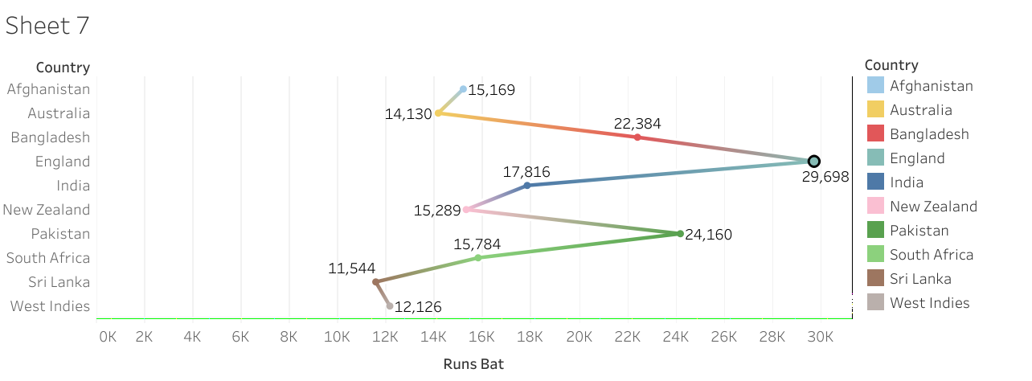
TEAM RUNS

Slide 15

METHODOLOGY
Data Collection
Data Pre-processing for data analysis
Apply Machine learning model
User defined functions for Predictions

Slide 16
STEP BY STEP PROCEDURE
Data Pre-processing for aggregation calculations, evaluating winning teams
Extracting Train & Test dataset
Exploratory Data Analysis
Predicting results on 2019 data
Predicting on the test dataset
Training the model using Logistic regression
Analyse who wins the most number of matches & compare the data with actual result to evaluate the accuracy.

Slide 17
DATA PRESENTATION
Predicted results are matching closely to actual result, however we are able to predict the
world cup winner with our model.
Team | Classifier Probability | Predicted Result | Actual Result
Afghanistan | 0.50% | Group Stage | Group Stage
Australia | 10.00% | Group Stage | Semi Finals
Bangladesh | 3% | Group Stage | Group Stage
England | 21.00% | Winners | Winners
India | 18.00% | Finalists | Semi Finals
New Zealand | 14.50% | Semi Finals | Finalists
Pakistan | 17.50% | Semi Finals | Group Stage
South Africa | 8.50% | Group Stage | Group Stage
Sri Lanka | 3.50% | Group Stage | Group Stage
West Indies | 3.50% | Group Stage | Group Stage

Slide 18
NATURAL LANGUAGE PROCESSING

Slide 19
Concept mainly required to build chatbot
A chat bot typically has 3 things in it
Intent ( Intention of the query asked by the user)
Entities ( Named entities in Query like , Location names, People names, date and etc…) #NamedEntityRecognization
Action or Response ( the result to throw back to the user)

Slide 20
Files for Rasa Core model
data/stories.md file contains some training stories which represent the conversations between a user and the assistant.
domain.yml file describes the domain of the assistant which includes intents, entities, slots, templates and actions the assistant should be aware of.
actions.py file contains the code of a custom action which retrieves results of the latest IPL match by making an external API call.
endpoints.yml file contains the webhook configuration for custom action.
policies.yml file contains the configuration of the training policies for Rasa Core model.

Slide 21
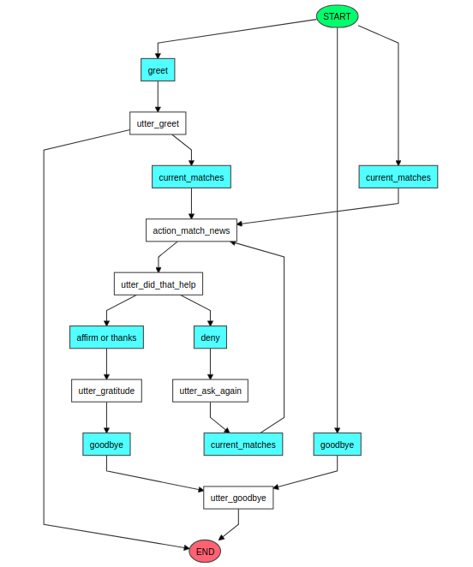
Chat bot Flow

Slide 22
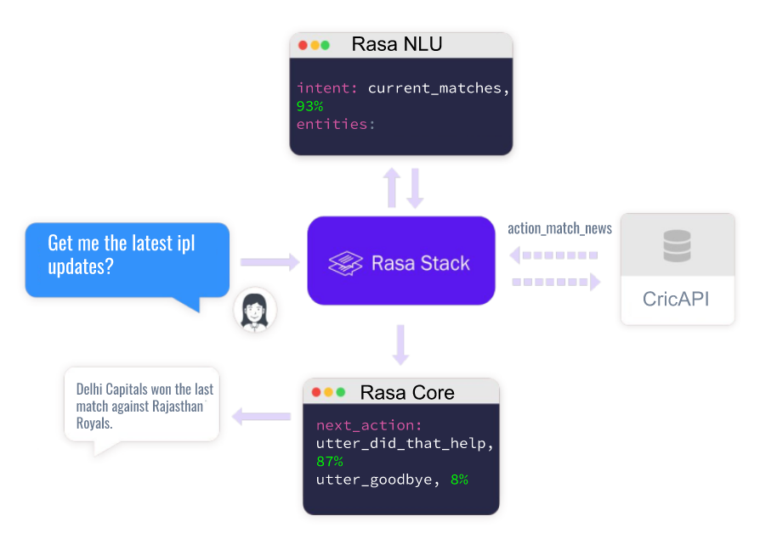
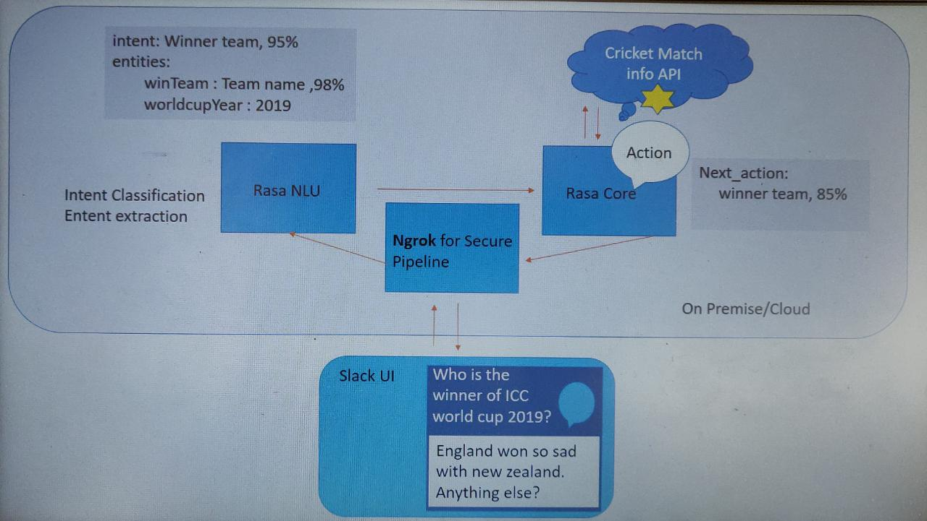
Chat bot Working

Slide 23
THANK YOU

